Slide 1
Tea Garden Automated Sprinkler System and Mobile App using IoT
Shariar Hasan Supervised by:
ID: 18701012 Dr. Muhammad Sanaullah Chowdhury
Session: 2017-18 Professor
Department of Computer Science And Engineering,
University of Chittagong

Slide 2
Problem Statement
Overuse and less use of the water
Watering tea plant depends on humidity or rain
Restrictions on multiple species of tea plants in same land

Slide 3
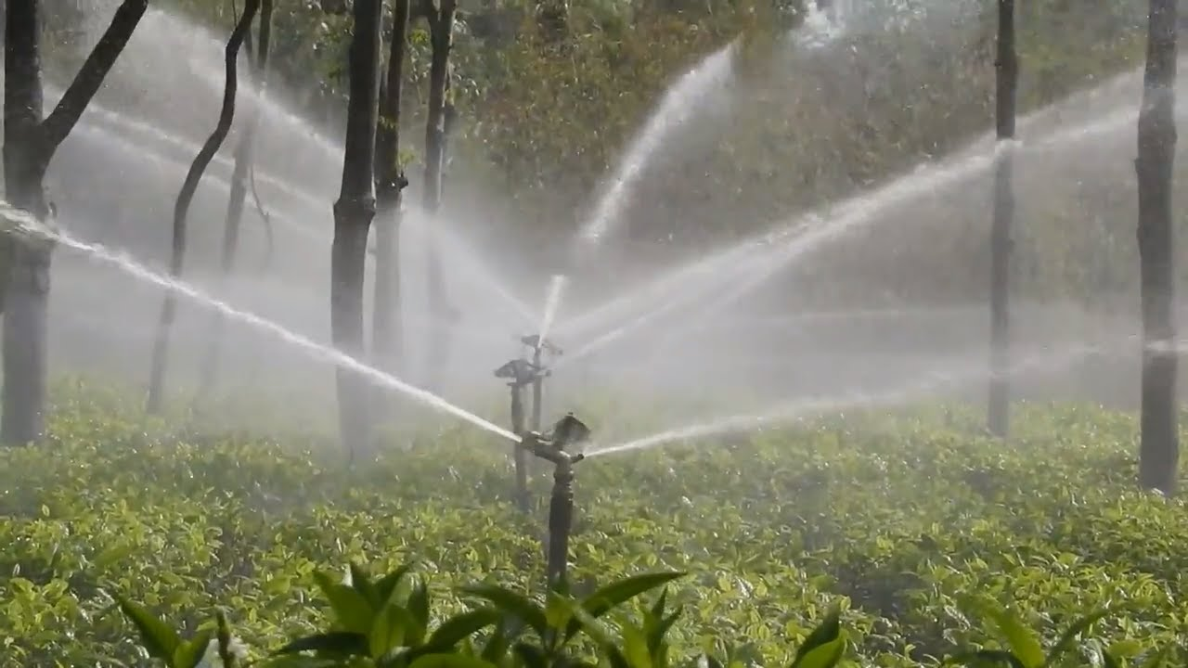
Motivation
No need to go outside to water
No need to actively monitor
Saves time
Saves water
Saves money
Boring process to easy process

Slide 4
Related works
Chandan Kumar Sahu and Pramitee Behera, “A low cost smart irrigation control system”
Joaqu´ın Gutierrez, Juan Francisco Villa-Medina, “Automated irrigation system using a wireless sensor network and gprs module”
Karan Kansara, Vishal Zaveri, “Sensor based automated irrigation system with iot”

Slide 5
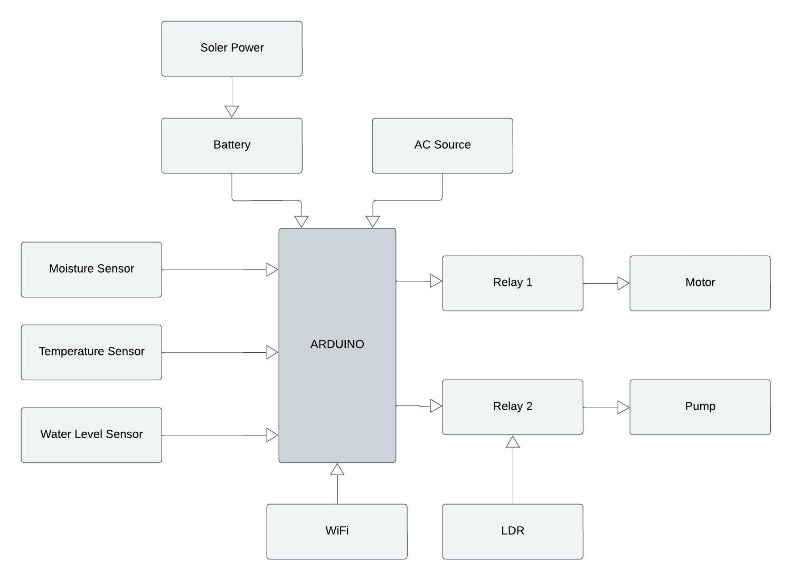
Methodology
Sensors used:
Soil moisture sensor
Temperature sensor
Water level detector
Tools:
Arduino
Relay

Slide 6
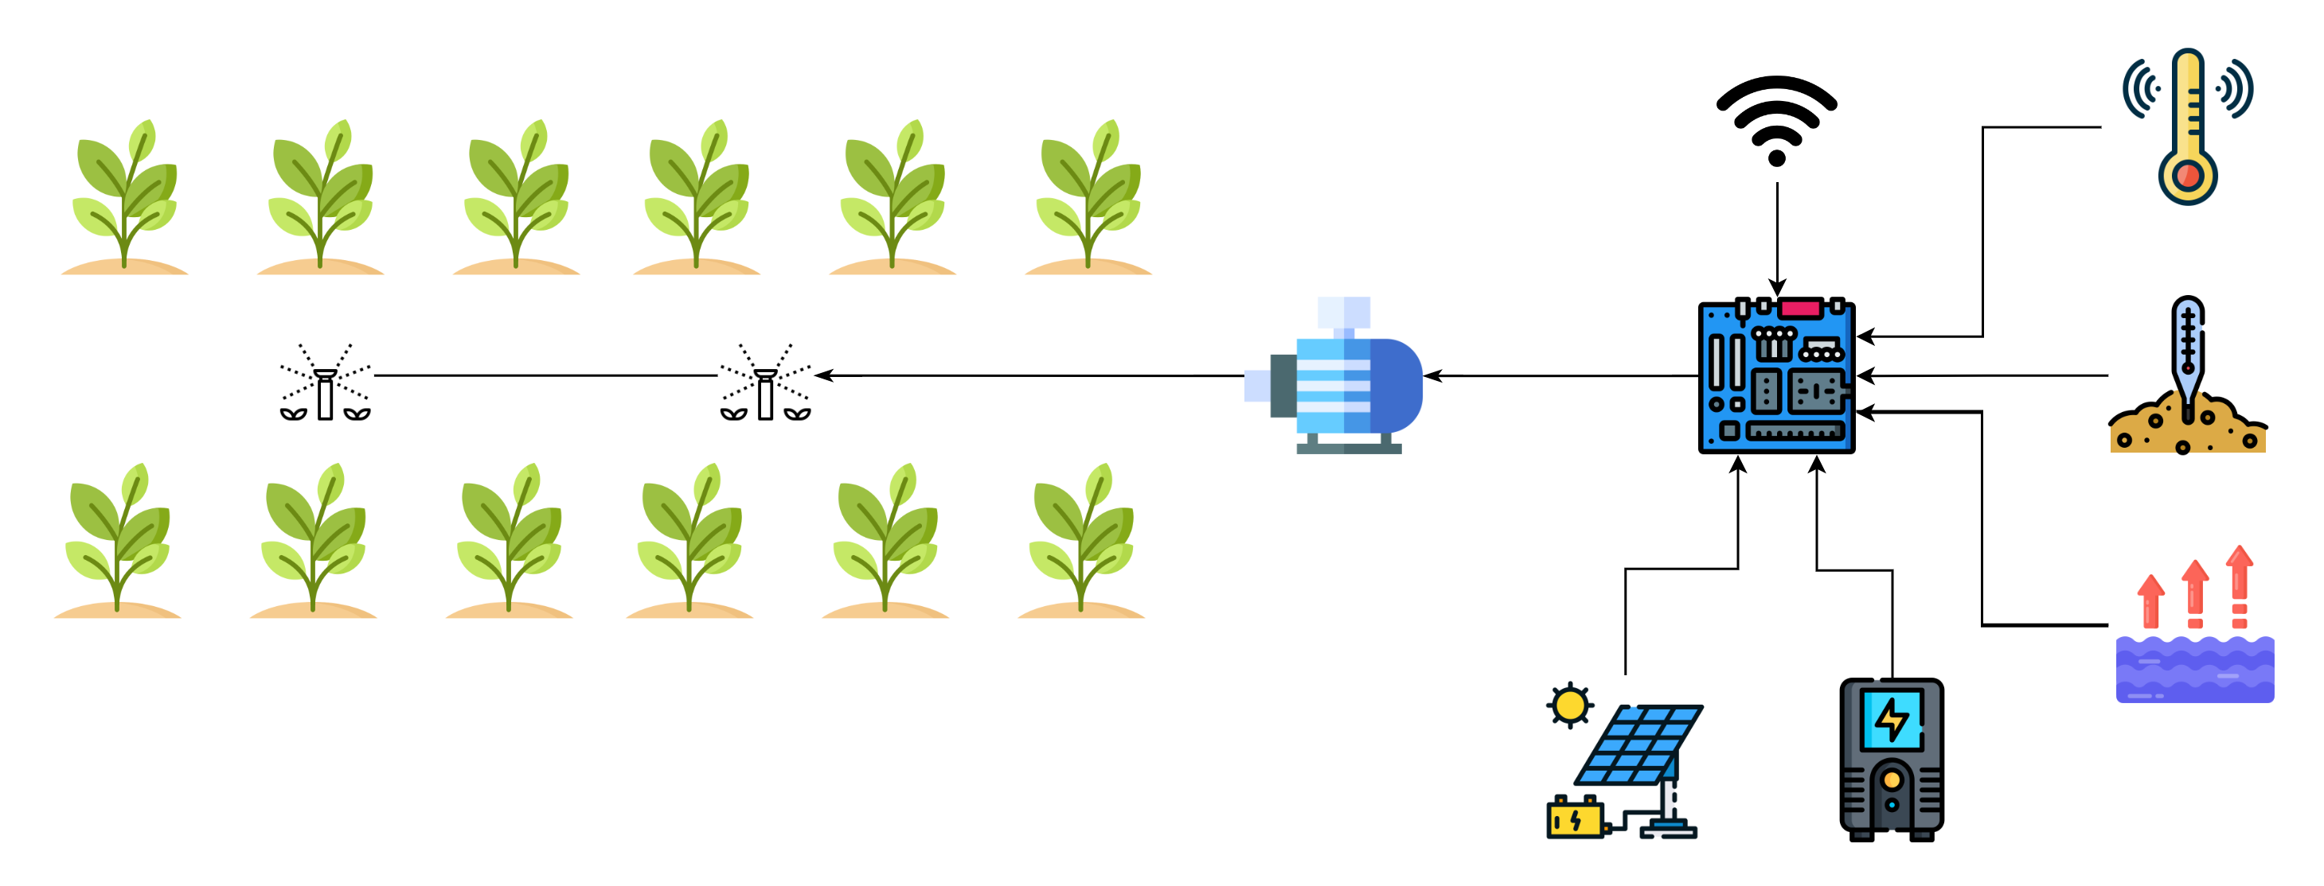
Methodology

Slide 7
Preliminary Result
The proposed system is not build yet.
Some of the devices are been collected.

Slide 8
Preliminary Result
Tool Name | Approximate Cost (BDT)
Arduino UNO | 1050
Soil Moisture Sensor | 820
Temperature Sensor | 100
Water Level Sensor | 90
WiFi Module | 230
Solar Panel | 720
Bread Board | 140
Power Adapter | 690
others | 200
Total | 4040

Slide 9
Future Work
Arrange all the devices, tools and sensors
Visiting a tea garden
Implement the system
Implement the mobile app
Work on it to make it more better

Slide 10
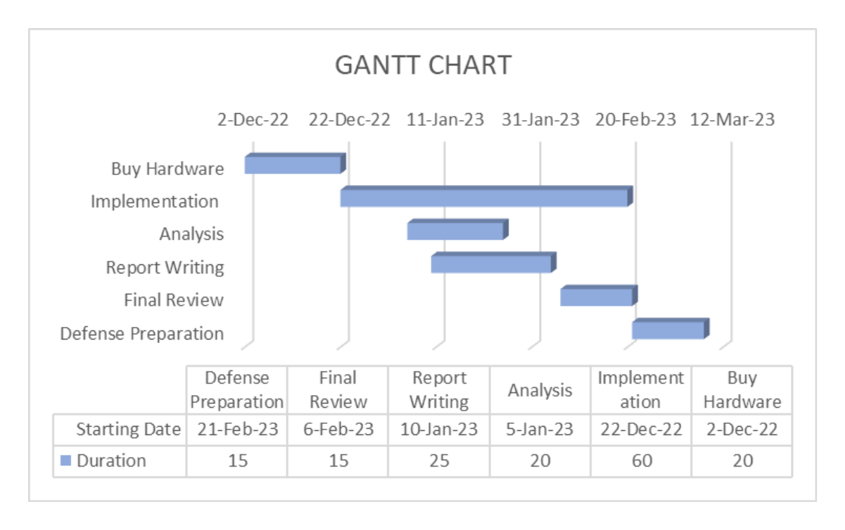
Future Work

Slide 11
Conclusion
This project provides smart irrigation system
This system helps in:
Reducing:
Time
Cost
Workload
Saving water
Multitasking

Slide 12
Thank You

